Slide 1
D MUGILVANAN
B. TECH
AI & DS
211521243101
3/21/2024 Annual Review

Slide 2
TITLE
Language Translation and Paraphrasing
3/21/2024 Annual Review

Slide 3


AGENDA
Introduction
Project Overview
Implementation Details
Additional Processes
Demonstration
Conclusion & Discussion
3/21/2024 Annual Review

Slide 4

PROBLEM STATEMENT
Traditional machine translation and paraphrasing methods often struggle to accurately capture contextual nuances and maintain fluency across languages, hindering effective communication and content adaptation.
3/21/2024 Annual Review

Slide 5

PROJECT OVERVIEW
This project aims to address the limitations of existing language translation and paraphrasing systems by leveraging state-of-the-art deep learning models to generate high-quality translations and paraphrases that preserve semantic meaning and contextual coherence.
3/21/2024 Annual Review

Slide 6

WHO ARE THE END USERS?
The end users of this system include individuals, businesses, and organizations that require multilingual communication tools, content localization services, and creative writing assistance.
3/21/2024 Annual Review

Slide 7

YOUR SOLUTION AND ITS VALUE PROPOSITION
The proposed solution involves the development of neural network-based models, including Convolutional Neural Networks (CNNs), Recurrent Neural Networks (RNNs), Graph Neural Networks (GNNs), and Autoencoders, to perform language translation and paraphrasing tasks effectively. These models will be trained on large-scale multilingual datasets to learn the intricacies of language structures and semantic relationships.
3/21/2024 Annual Review

Slide 8

THE WOW IN YOUR SOLUTION
The wow factor of this project lies in its ability to accurately translate text between multiple languages while preserving semantic meaning and contextual nuances, as well as to generate paraphrases that maintain fluency and coherence across languages. Additionally, the incorporation of advanced deep learning techniques ensures the system's adaptability to various linguistic styles and contexts.
3/21/2024 Annual Review

Slide 9
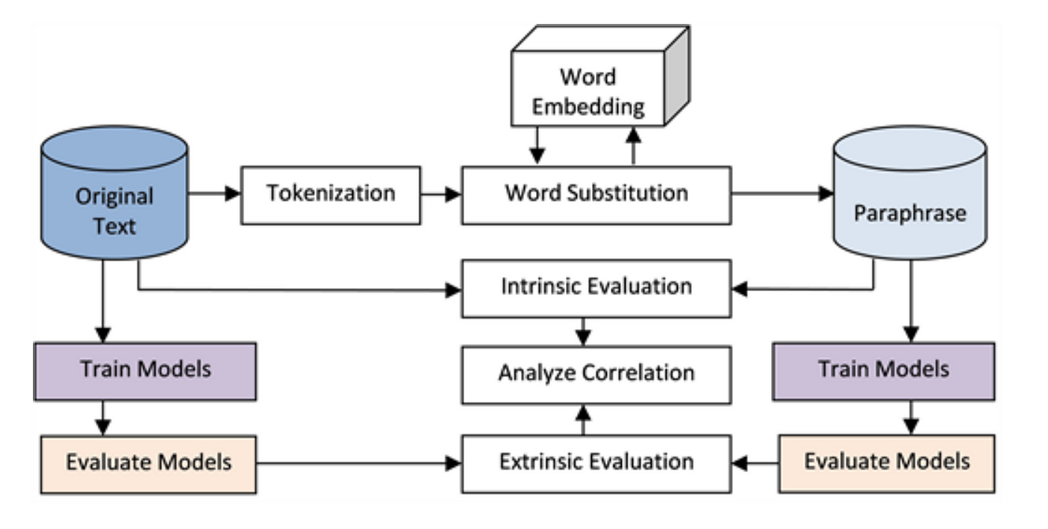
MODELLING
3/21/2024 Annual Review

Slide 10
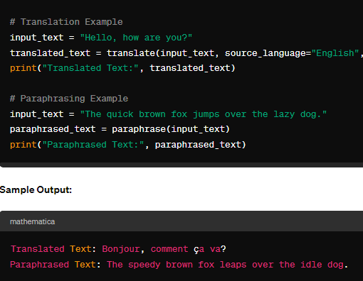
RESULTS
Demo Link
3/21/2024 Annual Review

